Slide 1
Capstone Engagement
Assessment, Analysis, and Hardening of a Vulnerable System

Slide 2
Table of Contents
This document contains the following sections:
01
Network Topology
02
Red Team: Security Assessment
03
Blue Team: Log Analysis and Attack Characterization
Hardening: Proposed Alarms and Mitigation Strategies
04

Slide 3
Network Topology
‹#›

Slide 4
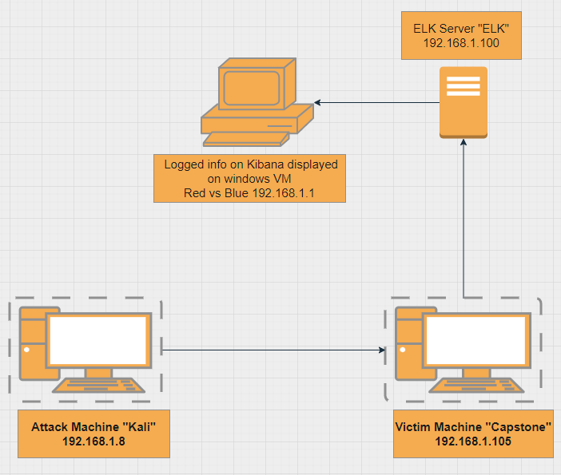
Network Topology
Network
Address Range: 192.168.1.100/24
Netmask: 255.255.255.0
Gateway: 192.168.1.1
Machines
IPv4: 192.168.1.8
OS: Linux
Hostname: Kali
IPv4: 192.168.1.105
OS: Linux
Hostname: Capstone
IPv4: 192.168.0.100
OS: Linux
Hostname: Elk
IPv4: 192.168.1.1
OS: Windows
Hostname: Red vs Blue

Slide 5

Red Team
Security Assessment
‹#›

Slide 6
Recon: Describing the Target
Nmap identified the following hosts on the network:
Hostname | IP Address | Role on Network
Red vs Blue WebVM | 192.168.1.1 | Host machine for the other VM’s on network.
Kali | 192.168.1.8 | Attack machine
Capstone | 192.168.1.100 | Vulnerable machine
ELK | 192.168.1.105 | Logs activity from the capstone machine.

Slide 7
Vulnerability Assessment
The assessment uncovered the following critical vulnerabilities in the target:
Vulnerability | Description | Impact
Open Port 80 with public access | Open ports can allow attackers to access information through the open port. | This allowed the directory with accessible files to be located.
Access to files via Web interface | Servers may store files in the root directory that is accessible to users. | This allowed the attacker to sniff through files available to obtain the servers user credentials.
Brute force vulnerability | When brute force is not protected against, an attacker can use a brute force tool to get the credentials of a user. | This allowed the attacker to gain Ashtons password to access the secret folder.
Hashed password | A hashed password can be easily cracked with a hash crack tool. | This allowed the attacker to use crackstation online to crack the password in seconds.

Slide 8
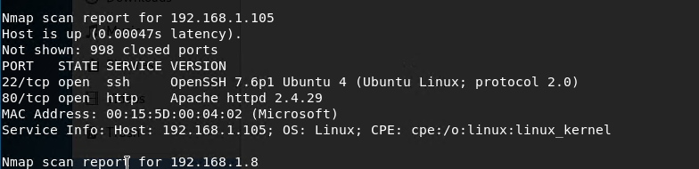
Exploitation: Open Port 80
01
02
I used Nmap to scan or any open ports and services within our subnet.
I was able to find that IP 192.168.1.105 had an open port 80, through which we were able to access through the web interface.

Slide 9
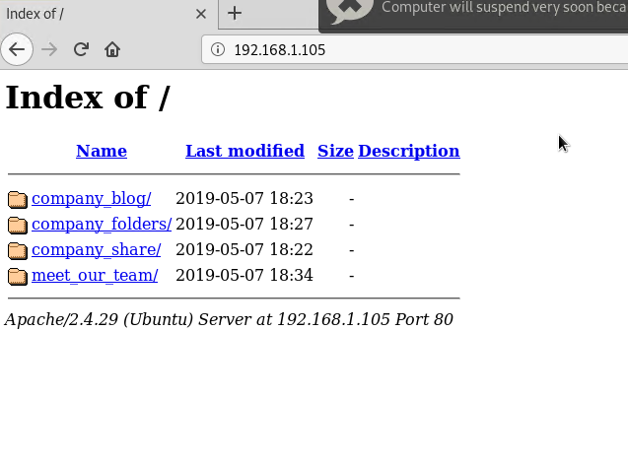
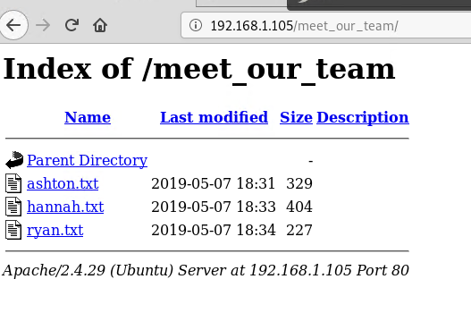
Exploitation: Access to Files Via Web Interface
01
02
Using port 80 I was able to open a Web browser to see if there were files accessible to the public.
I was able to explore meet our team folder and find which users had access to the secret folder and the folder location.

Slide 10
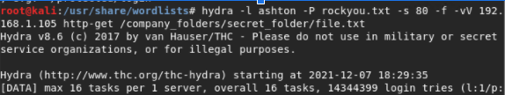
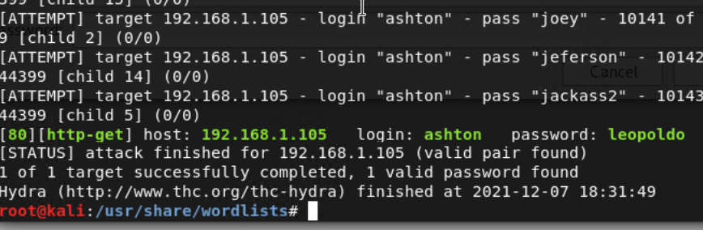
Exploitation: Brute Force
01
Using the Brute force tool Hydra I was able to get Ashton’s password
02
After obtaining Ashton’s password I was able to get access to the secret folder to view a file.txt for instructions on how to access the server with Ryan’s credentials.

Slide 11

Blue Team
Log Analysis and Attack Characterization
‹#›

Slide 12

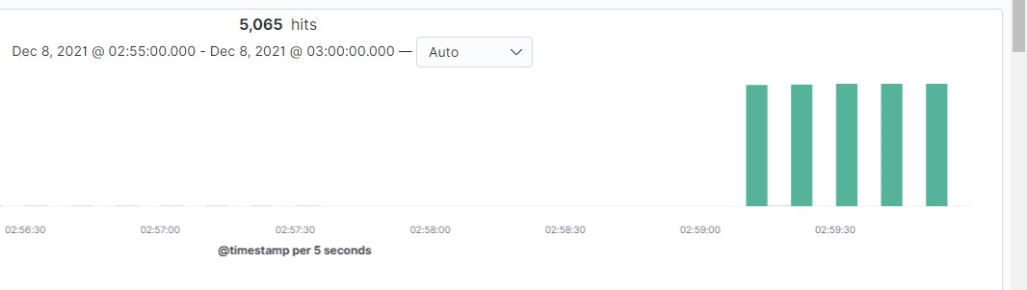
Analysis: Identifying the Port Scan
The port scan occurred at 2:59:50
5,065 hits were sent from 192.168.1.8
The initial spikes in traffic from the same source port is a good indicator of the nmap scan.
[Insert Here]
Include a screenshot of Kibana logs depicting the port scan.

Slide 13
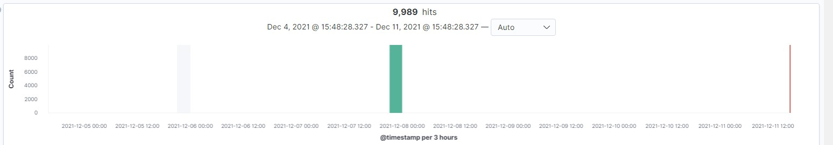

Analysis: Finding the Request for the Hidden Directory
The request were made at 5:48 pm? 9,989 total request were made to the hidden directory.
A file.txt is located inside a hidden secret_folder located inside the company folders. The file.txt contained instructions on how to access webdav using ryans credentials.

Slide 14
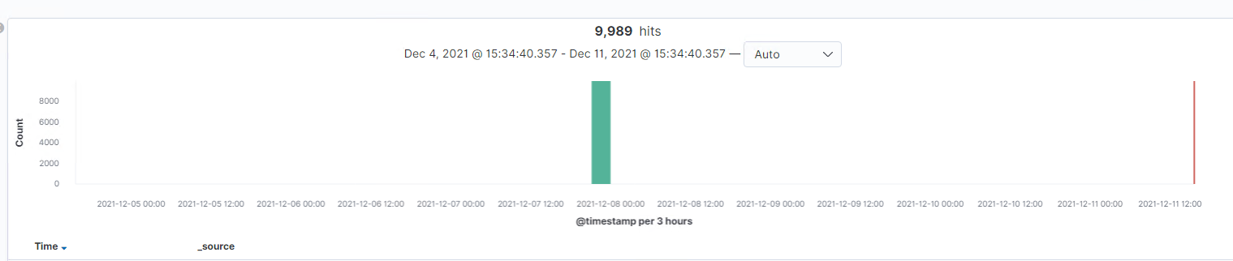
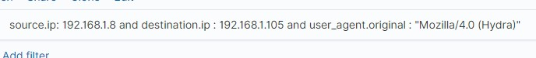
Analysis: Uncovering the Brute Force Attack
There were 9,989 request made in the Brute force attack from the tool Hydra.
[Insert Here]
Include a screenshot of Kibana logs depicting the brute force attack.

Slide 15
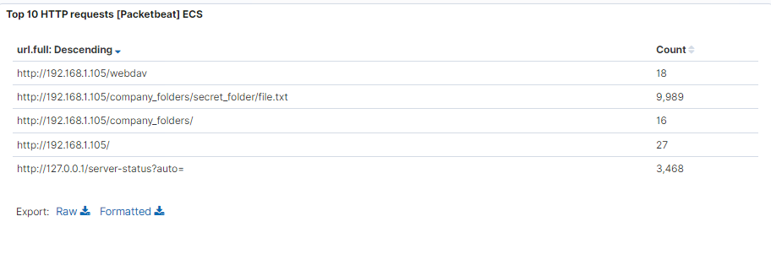
Analysis: Finding the WebDAV Connection
There were 9.989 request to the webdav directory.
The shell.php file was requested to be used for a reverse shell attack.
[Insert Here]
Add a screenshot of Kibana logs depicting the WebDAV connection.

Slide 16
Blue Team
Proposed Alarms and Mitigation Strategies
‹#›

Slide 17
Mitigation: Blocking the Port Scan
I would set up an alarm that would alert when the firewall detects a upswing in port scans within a minute.
I would set the threshold of more than 10 port scans per minute before the alarm is triggered.
Configure firewall to block all scans from unknown IP addresses.
The administrator can set up the firewall to block all scans from outside sources, such as IP addresses and domain names not used for daily operations.

Slide 18
Mitigation: Finding the Request for the Hidden Directory
I would set an alert anytime this directory is attempted to be accessed.
I would set the threshold at 1.
I would remove this directory from the server.
To remove the directory use rm -r ./company_files.

Slide 19
Mitigation: Preventing Brute Force Attacks
I would set an alert that would alert any 401 errors from the server. I would set a threshold on the amount of attempts on a password before the user is locked out.
I would set a threshold of 5 attempts per hour.
After so many 401 error are returned from a server, that server can drop the traffic from the attacking IP address.
After 5 failed attempts I would have a lockout page displayed to where no more attempts can be made.

Slide 20
Mitigation: Detecting the WebDAV Connection
Create an alert if this directory is accessed by an IP address unknown. Also, an alert anytime a 401 error message comes from the server for a failed attempt to access this directory.
The threshold would be 1 attempt.
This directory should not be accessible from the web interface.
Create a firewall rule for connections to this folder.

Slide 21
Mitigation: Identifying Reverse Shell Uploads
Set an alert for any .php file uploaded to the server.
The threshold would be 1.
Block the ability to upload files to this server via the web interface.
Block any traffic over the 4444 port.

